Slide 1
9
Classes:
A Deeper Look,
Part 1

Slide 2
My object all sublime I shall achieve in time.
  W. S. Gilbert
Is it a world to hide virtues in?
  William Shakespeare
Don’t be “consistent,” but be simply true.
  Oliver Wendell Holmes, Jr.
This above all: to thine own self be true.
  William Shakespeare

Slide 3
OBJECTIVES
In this chapter you will learn:
How to use a preprocessor wrapper to prevent multiple definition errors caused by including more than one copy of a header file in a source-code file.
To understand class scope and accessing class members via the name of an object, a reference to an object or a pointer to an object.
To define constructors with default arguments.
How destructors are used to perform "termination housekeeping" on an object before it is destroyed.
When constructors and destructors are called and the order in which they are called.
The logic errors that may occur when a public member function of a class returns a reference to private data.
To assign the data members of one object to those of another object by default memberwise assignment.

Slide 4
9.1 Introduction
9.2 Time Class Case Study
9.3 Class Scope and Accessing Class Members
9.4 Separating Interface from Implementation
9.5 Access Functions and Utility Functions
9.6 Time Class Case Study: Constructors with Default Arguments
9.7 Destructors
9.8 When Constructors and Destructors Are Called
9.9 Time Class Case Study: A Subtle Trap—Returning a Reference to a private Data Member
9.10 Default Memberwise Assignment
9.11 Software Reusability
9.12 (Optional) Software Engineering Case Study: Starting to Program the Classes of the ATM System
9.13 Wrap-Up

Slide 5
9.1 Introduction
Integrated Time class case study
Preprocessor wrapper
Three types of “handles” on an object
  Name of an object
  Reference to an object
  Pointer to an object
Class functions
  Predicate functions
  Utility functions

Slide 6
9.1 Introduction (Cont.)
Passing arguments to constructors
Using default arguments in a constructor
Destructor
  Performs “termination housekeeping”

Slide 7
9.2 Time Class Case Study
Preprocessor wrappers
  Prevents code from being included more than once
    #ifndef – “if not defined”
      Skip this code if it has been included already
    #define
      Define a name so this code will not be included again
    #endif
  If the header has been included previously
    Name is defined already and the header file is not included again
  Prevents multiple-definition errors
  Example
    #ifndef TIME_H
    #define TIME_H
    … // code
    #endif

Slide 8
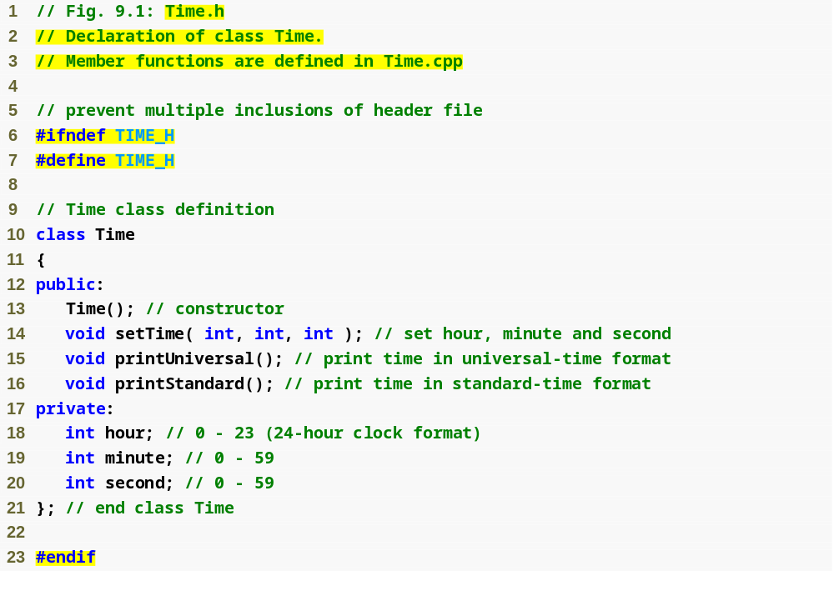
Outline
Preprocessor directive #ifndef determines whether a name is defined
Time.h
(1 of 1)
Preprocessor directive #define defines a name (e.g., TIME_H)
Preprocessor directive #endif marks the end of the code that should not be included multiple times

Slide 9
Good Programming Practice 9.1
For clarity and readability, use each access specifier only once in a class definition. Place public members first, where they are easy to locate.

Slide 10
Software Engineering Observation 9.1
Each element of a class should have private visibility unless it can be proven that the element needs public visibility. This is another example of the principle of least privilege.

Slide 11
Error-Prevention Tip 9.1
Use #ifndef, #define and #endif preprocessor directives to form a preprocessor wrapper that prevents header files from being included more than once in a program.

Slide 12
Good Programming Practice 9.2
Use the name of the header file in upper case with the period replaced by an underscore in the #ifndef and #define preprocessor directives of a header file.

Slide 13
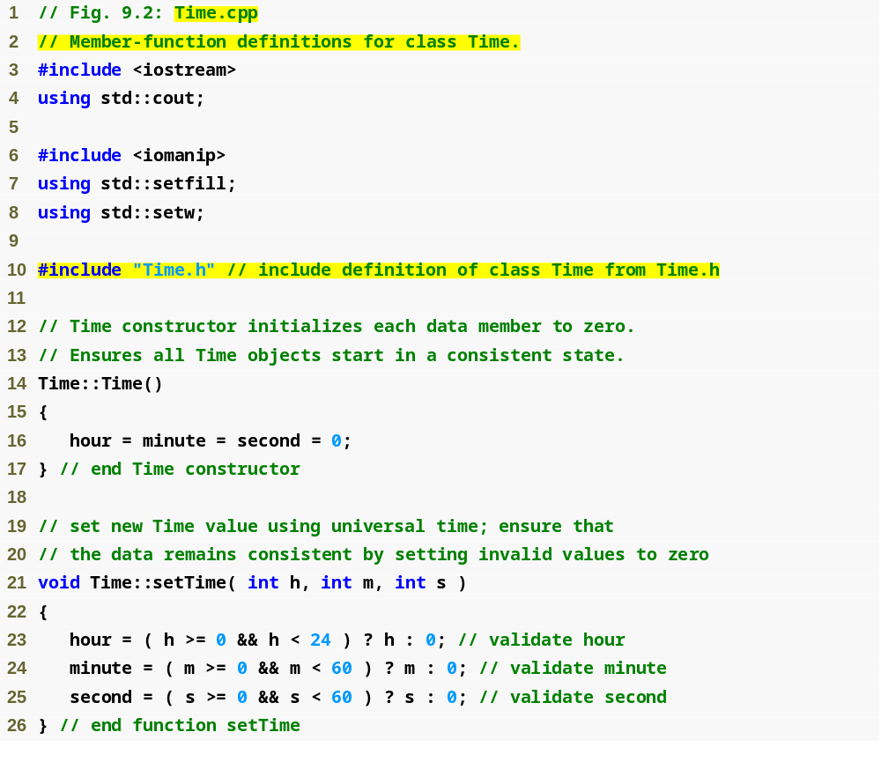
Outline
Time.cpp
(1 of 2)
Ensure that hour, minute and second values remain valid

Slide 14
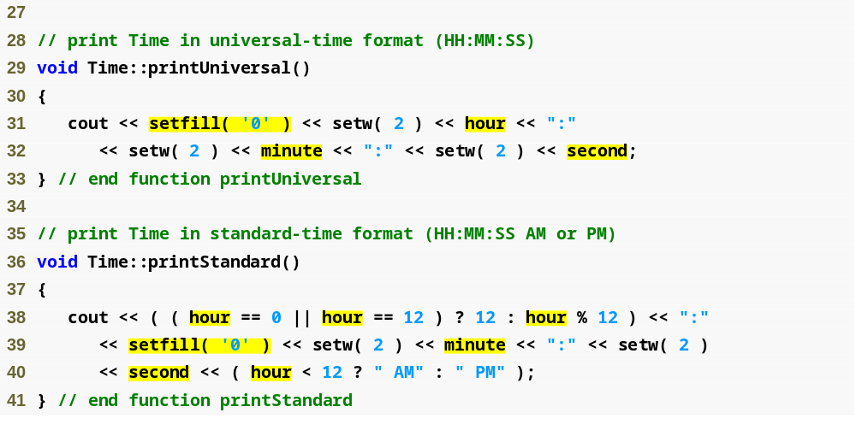
Outline
Using setfill stream manipulator to specify a fill character
Time.cpp
(2 of 2)

Slide 15
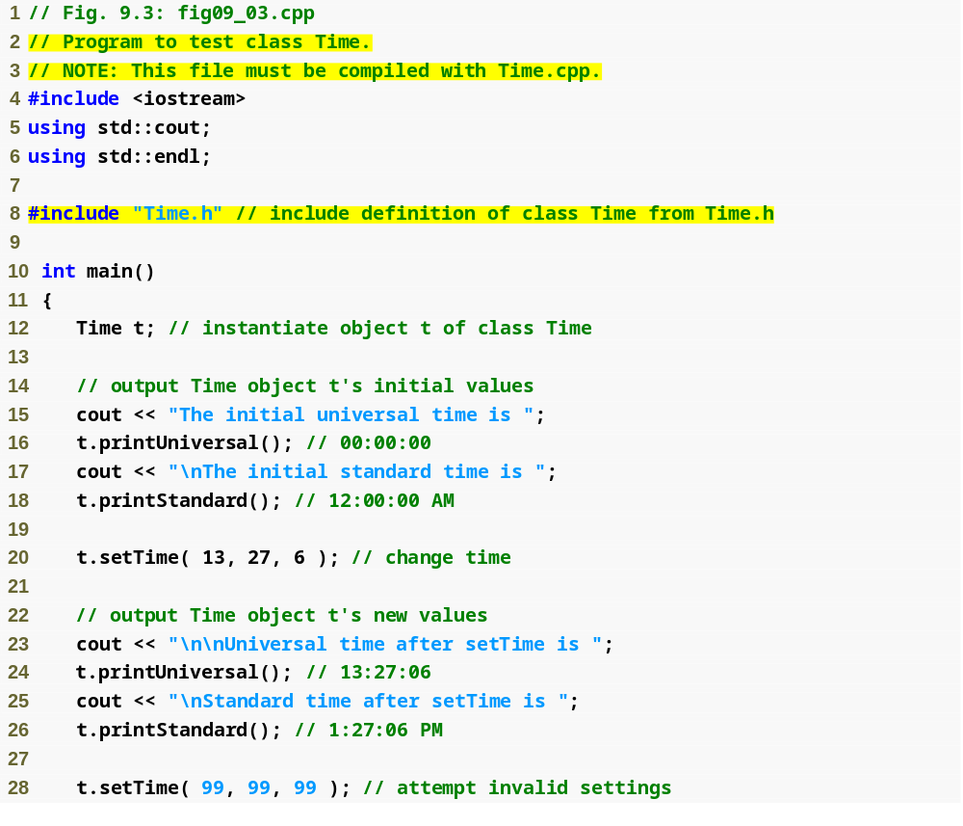
Outline
fig09_03.cpp
(1 of 2)

Slide 16
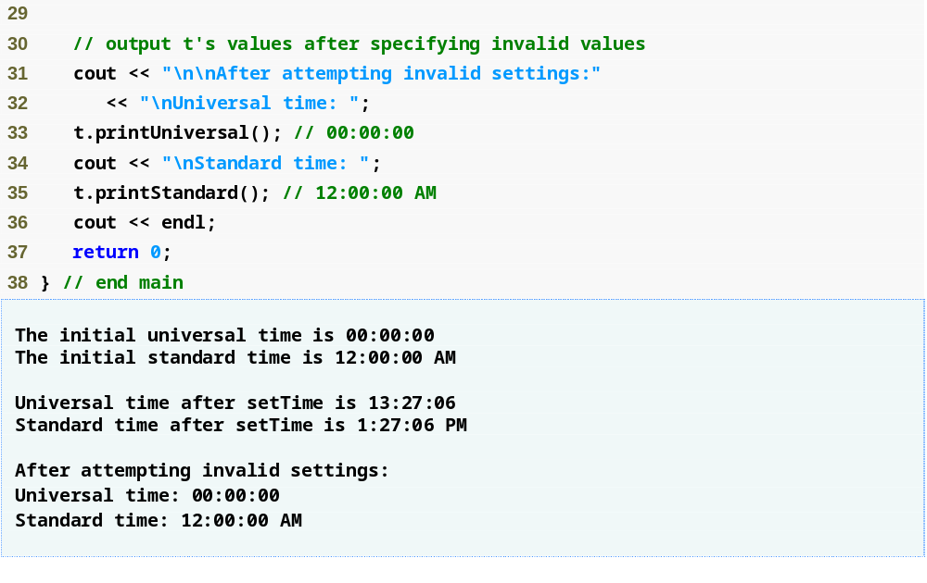
Outline
fig09_03.cpp
(2 of 2)

Slide 17
Common Programming Error 9.1
Attempting to initialize a non-static data member of a class explicitly in the class definition is a syntax error.

Slide 18
9.2 Time Class Case Study (Cont.)
Parameterized stream manipulator setfill
  Specifies the fill character
    Which is displayed when an output field wider than the number of digits in the output value
    By default, fill characters appear to the left of the digits in the number
  setfill is a “sticky” setting
    Applies for all subsequent values that are displayed in fields wider than the value being displayed

Slide 19
Error-Prevention Tip 9.2
Each sticky setting (such as a fill character or floating-point precision) should be restored to its previous setting when it is no longer needed. Failure to do so may result in incorrectly formatted output later in a program. Chapter 15, Stream Input/Output, discusses how to reset the fill character and precision.

Slide 20
9.2 Time Class Case Study (Cont.)
Member function declared in a class definition but defined outside that class definition
  Still within the class’s scope
  Known only to other members of the class unless referred to via
    Object of the class
    Reference to an object of the class
    Pointer to an object of the class
    Binary scope resolution operator
Member function defined in the body of a class definition
  C++ compiler attempts to inline calls to the member function

Slide 21
Performance Tip 9.1
Defining a member function inside the class definition inlines the member function (if the compiler chooses to do so). This can improve performance.

Slide 22
Software Engineering Observation 9.2
Defining a small member function inside the class definition does not promote the best software engineering, because clients of the class will be able to see the implementation of the function, and the client code must be recompiled if the function definition changes.

Slide 23
Software Engineering Observation 9.3
Only the simplest and most stable member functions (i.e., whose implementations are unlikely to change) should be defined in the class header.

Slide 24
Software Engineering Observation 9.4
Using an object-oriented programming approach can often simplify function calls by reducing the number of parameters to be passed. This benefit of object-oriented programming derives from the fact that encapsulating data members and member functions within an object gives the member functions the right to access the data members.

Slide 25
Software Engineering Observation 9.5
Member functions are usually shorter than functions in non-object-oriented programs, because the data stored in data members have ideally been validated by a constructor or by member functions that store new data. Because the data is already in the object, the member-function calls often have no arguments or at least have fewer arguments than typical function calls in non-object-oriented languages. Thus, the calls are shorter, the function definitions are shorter and the function prototypes are shorter. This facilitates many aspects of program development.

Slide 26
Error-Prevention Tip 9.3
The fact that member function calls generally take either no arguments or substantially fewer arguments than conventional function calls in non-object-oriented languages reduces the likelihood of passing the wrong arguments, the wrong types of arguments or the wrong number of arguments.

Slide 27
9.2 Time Class Case Study (Cont.)
Using class Time
  Once class Time has been defined, it can be used in declarations
    Time sunset;
    Time arrayOfTimes[ 5 ];
    Time &dinnerTime = sunset;
    Time *timePtr = &dinnerTime;

Slide 28
Performance Tip 9.2
Objects contain only data, so objects are much smaller than if they also contained member functions. Applying operator sizeof to a class name or to an object of that class will report only the size of the class’s data members. The compiler creates one copy (only) of the member functions separate from all objects of the class. All objects of the class share this one copy. Each object, of course, needs its own copy of the class’s data, because the data can vary among the objects. The function code is nonmodifiable (also called reentrant code or pure procedure) and, hence, can be shared among all objects of one class.

Slide 29
9.3 Class Scope and Accessing Class Members
Class scope contains
  Data members
    Variables declared in the class definition
  Member functions
    Functions declared in the class definition
Nonmember functions are defined at file scope

Slide 30
9.3 Class Scope and Accessing Class Members (Cont.)
Within a class’s scope
  Class members are accessible by all member functions
Outside a class’s scope
  public class members are referenced through a handle
    An object name
    A reference to an object
    A pointer to an object

Slide 31
9.3 Class Scope and Accessing Class Members (Cont.)
Variables declared in a member function
  Have block scope
  Known only to that function
Hiding a class-scope variable
  In a member function, define a variable with the same name as a variable with class scope
  Such a hidden variable can be accessed by preceding the name with the class name followed by the scope resolution operator (::)

Slide 32
9.3 Class Scope and Accessing Class Members (Cont.)
Dot member selection operator (.)
  Accesses the object’s members
  Used with an object’s name or with a reference to an object
Arrow member selection operator (->)
  Accesses the object’s members
  Used with a pointer to an object

Slide 33
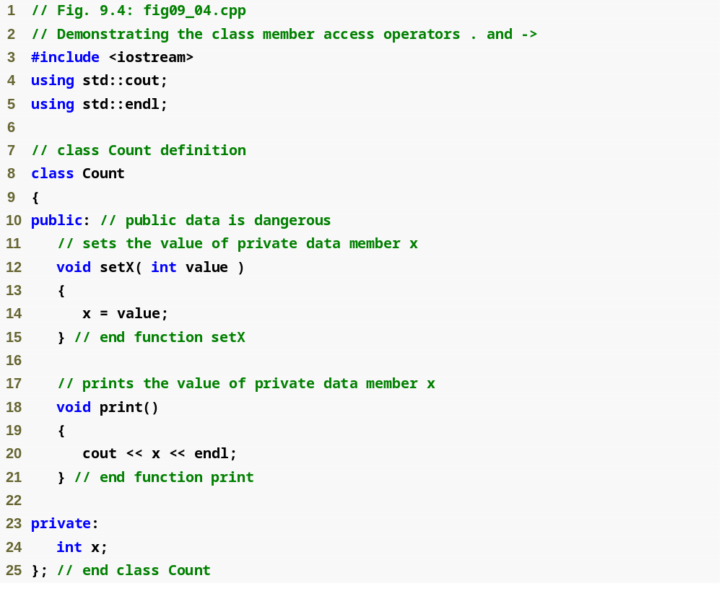
Outline
fig09_04.cpp
(1 of 2)

Slide 34
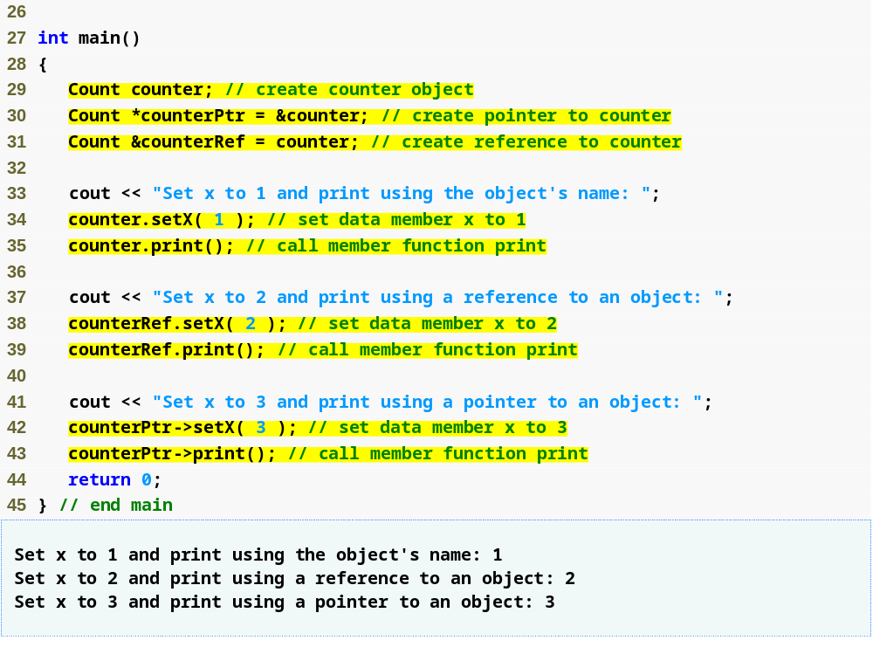
Outline
fig09_04.cpp
(2 of 2)
Using the dot member selection operator with an object
Using the dot member selection operator with a reference
Using the arrow member selection operator with a pointer

Slide 35
9.4 Separating Interface from Implementation
Separating a class definition and the class’s member-function definitions
  Makes it easier to modify programs
    Changes in the class’s implementation do not affect the client as long as the class’s interface remains unchanged
  Things are not quite this rosy
    Header files do contain some portions of the implementation and hint about others
      Inline functions need to be defined in header file
      private members are listed in the class definition in the header file

Slide 36
Software Engineering Observation 9.6
Clients of a class do not need access to the class’s source code in order to use the class. The clients do, however, need to be able to link to the class’s object code (i.e., the compiled version of the class). This encourages independent software vendors (ISVs) to provide class libraries for sale or license. The ISVs provide in their products only the header files and the object modules. No proprietary information is revealed—as would be the case if source code were provided. The C++ user community benefits by having more ISV-produced class libraries available.

Slide 37
Software Engineering Observation 9.7
Information important to the interface to a class should be included in the header file. Information that will be used only internally in the class and will not be needed by clients of the class should be included in the unpublished source file. This is yet another example of the principle of least privilege.

Slide 38
9.5 Access Functions and Utility Functions
Access functions
  Can read or display data
  Can test the truth or falsity of conditions
    Such functions are often called predicate functions
    For example, isEmpty function for a class capable of holding many objects
Utility functions (also called helper functions)
  private member functions that support the operation of the class’s public member functions
  Not part of a class’s public interface
    Not intended to be used by clients of a class

Slide 39
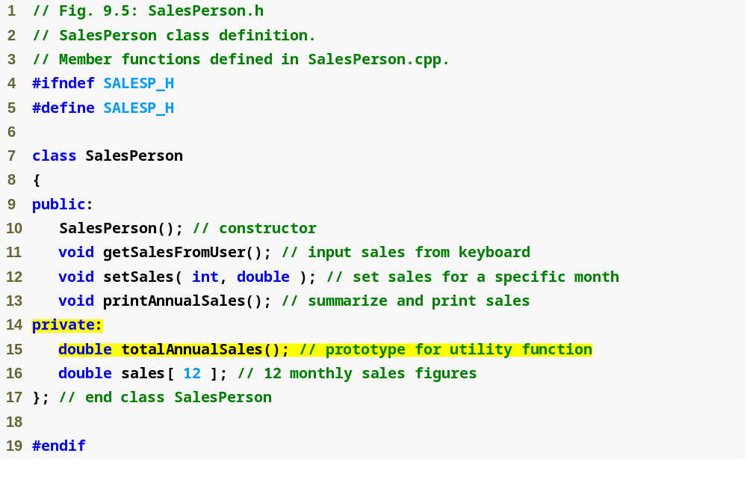
Outline
SalesPerson.h
(1 of 1)
Prototype for a private utility function

Slide 40
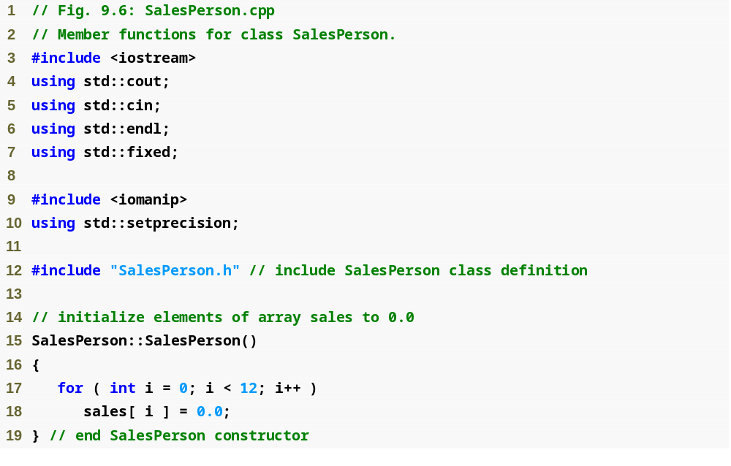
Outline
SalesPerson.cpp
(1 of 3)

Slide 41
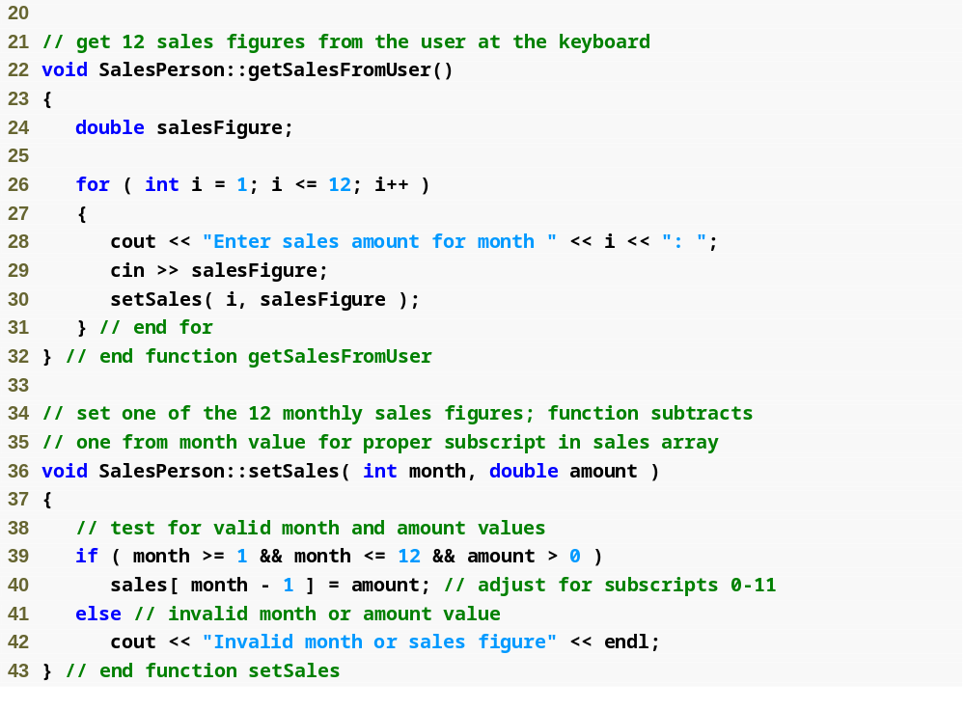
Outline
SalesPerson.cpp
(2 of 3)

Slide 42
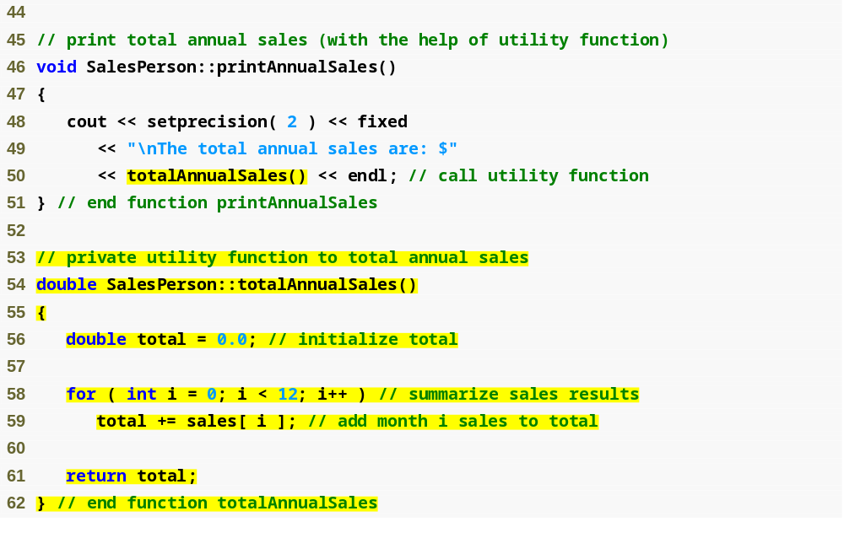
Outline
Calling a private utility function
SalesPerson.cpp
(3 of 3)
Definition of a private utility function

Slide 43
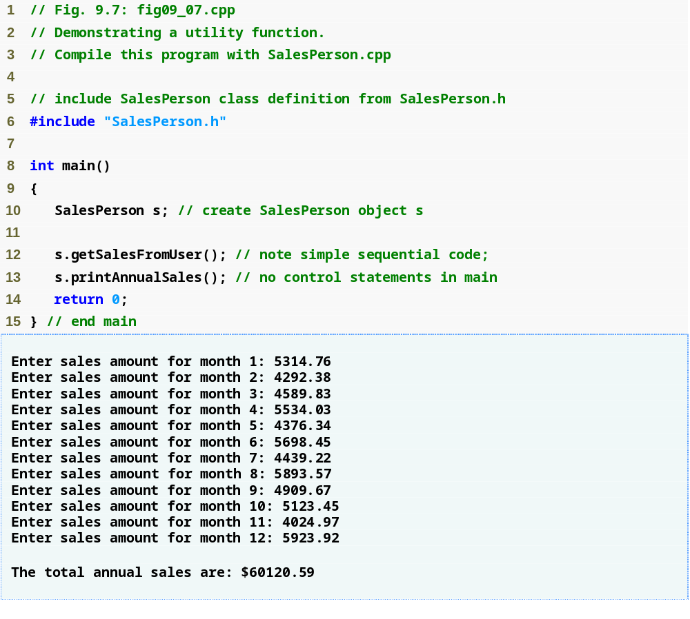
Outline
fig09_07.cpp
(1 of 1)

Slide 44
Software Engineering Observation 9.8
A phenomenon of object-oriented programming is that once a class is defined, creating and manipulating objects of that class often involve issuing only a simple sequence of member-function calls—few, if any, control statements are needed. By contrast, it is common to have control statements in the implementation of a class’s member functions.

Slide 45
9.6 Time Class Case Study: Constructors with Default Arguments
Constructors can specify default arguments
  Can initialize data members to a consistent state
    Even if no values are provided in a constructor call
  Constructor that defaults all its arguments is also a default constructor
    Can be invoked with no arguments
    Maximum of one default constructor per class

Slide 46
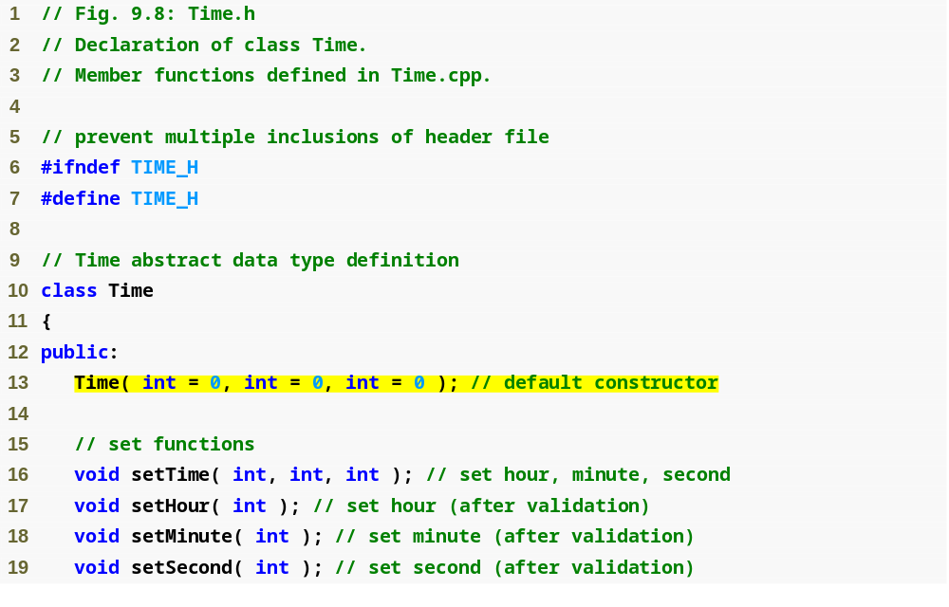
Outline
Time.h
(1 of 2)
Prototype of a constructor with default arguments

Slide 47
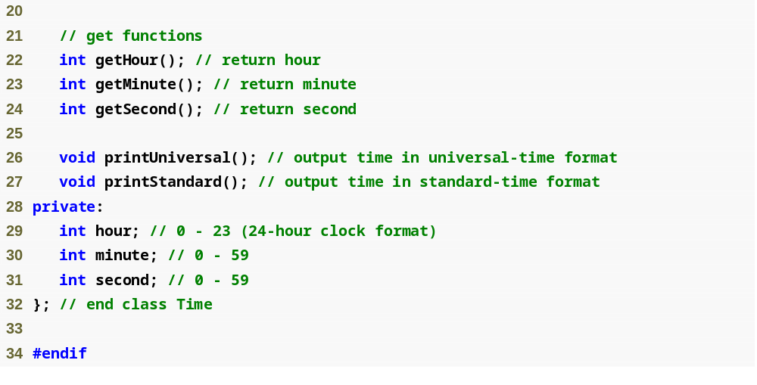
Outline
Time.h
(2 of 2)

Slide 48
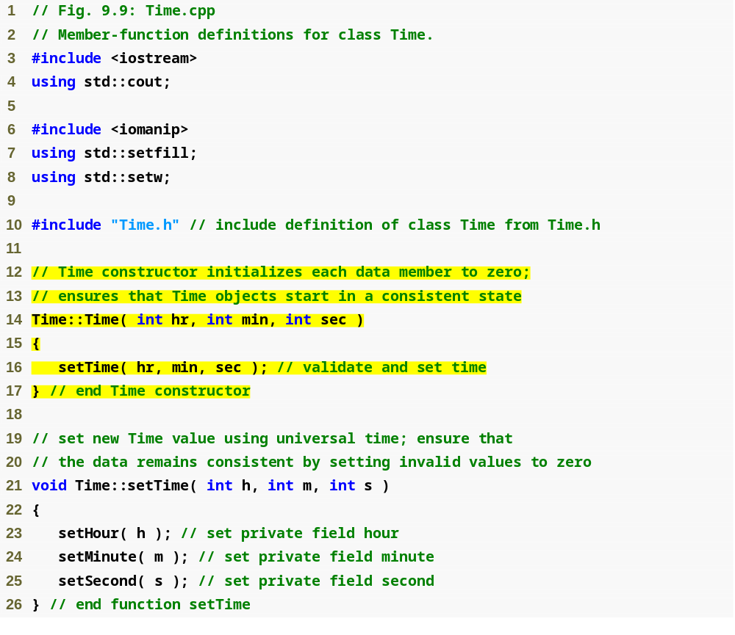
Outline
Time.cpp
(1 of 3)
Parameters could receive the default values

Slide 49
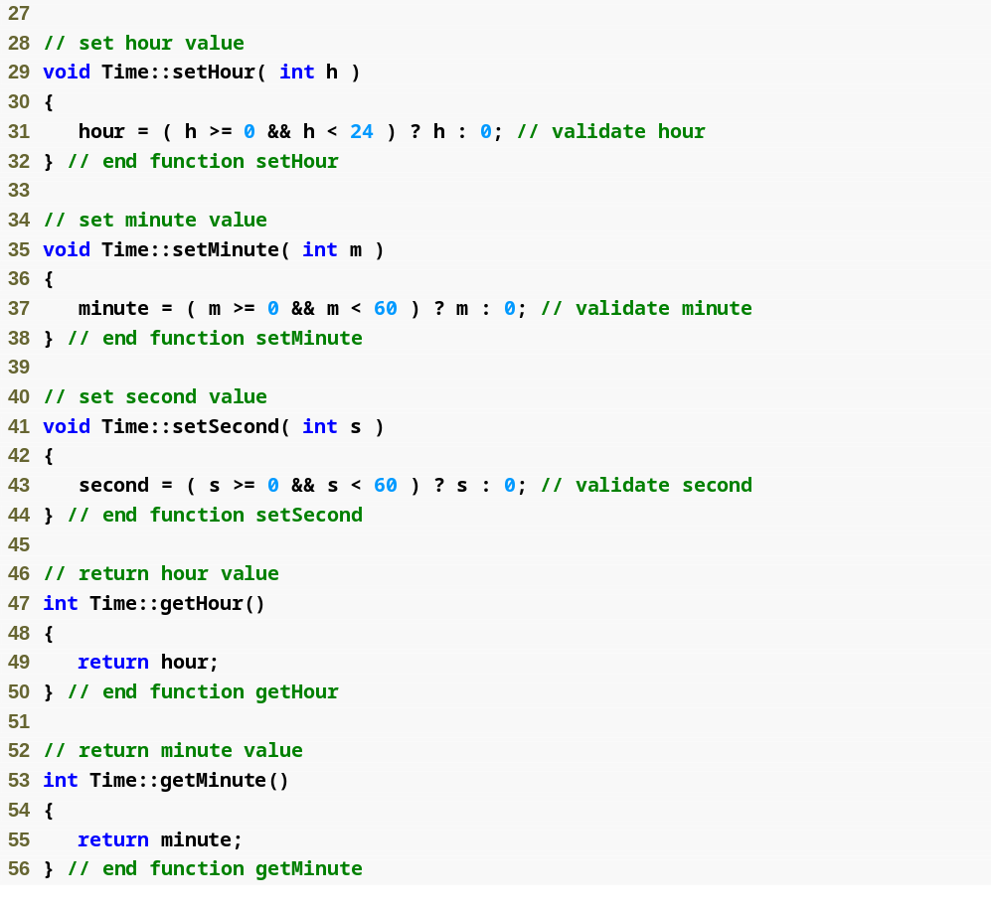
Outline
Time.cpp
(2 of 3)

Slide 50
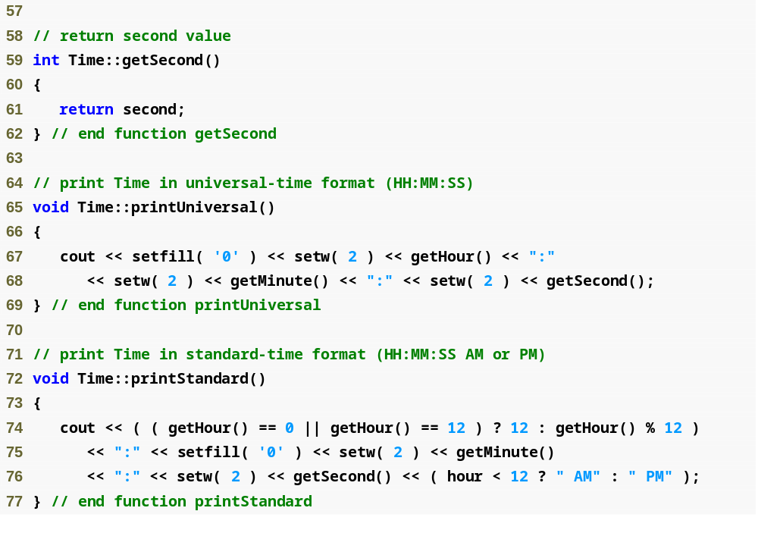
Outline
Time.cpp
(3 of 3)

Slide 51
Software Engineering Observation 9.9
If a member function of a class already provides all or part of the functionality required by a constructor (or other member function) of the class, call that member function from the constructor (or other member function). This simplifies the maintenance of the code and reduces the likelihood of an error if the implementation of the code is modified. As a general rule: Avoid repeating code.

Slide 52
Software Engineering Observation 9.10
Any change to the default argument values of a function requires the client code to be recompiled (to ensure that the program still functions correctly).

Slide 53
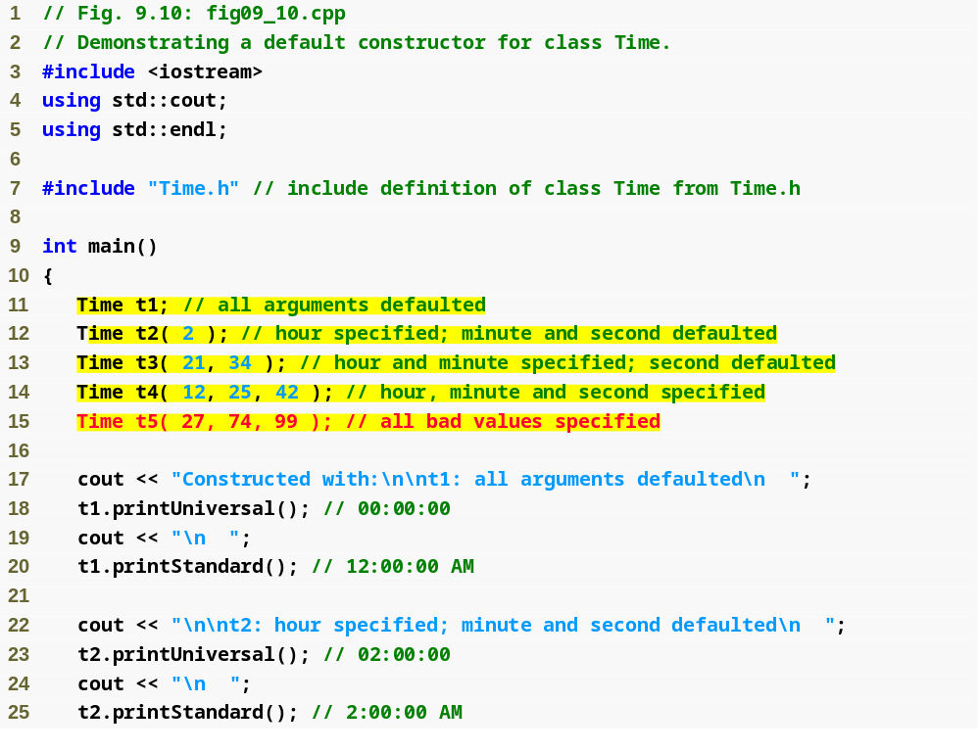
Outline
fig09_10.cpp
(1 of 3)
Initializing Time objects using 0, 1, 2 and 3 arguments

Slide 54
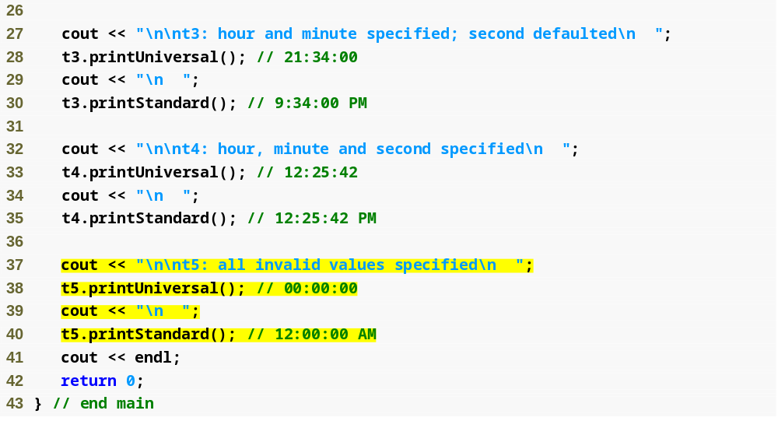
Outline
fig09_10.cpp
(2 of 3)

Slide 55
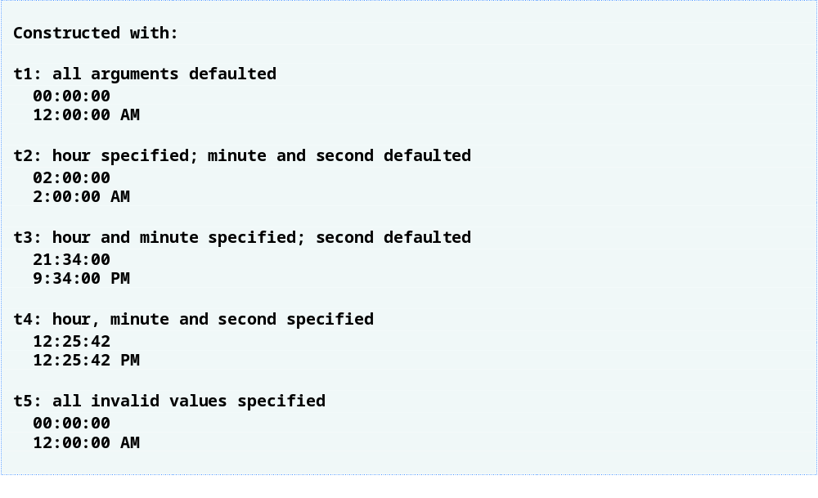
Outline
fig09_10.cpp
(3 of 3)
Invalid values passed to constructor, so object t5 contains all default data

Slide 56
Common Programming Error 9.2
A constructor can call other member functions of the class, such as set or get functions, but because the constructor is initializing the object, the data members may not yet be in a consistent state. Using data members before they have been properly initialized can cause logic errors.

Slide 57
9.7 Destructors
Destructor
  A special member function
  Name is the tilde character (~) followed by the class name, e.g., ~Time
  Called implicitly when an object is destroyed
    For example, this occurs as an automatic object is destroyed when program execution leaves the scope in which that object was instantiated
  Does not actually release the object’s memory
    It performs termination housekeeping
    Then the system reclaims the object’s memory
      So the memory may be reused to hold new objects

Slide 58
9.7 Destructors (Cont.)
Destructor (Cont.)
  Receives no parameters and returns no value
    May not specify a return type—not even void
  A class may have only one destructor
    Destructor overloading is not allowed
  If the programmer does not explicitly provide a destructor, the compiler creates an “empty” destructor

Slide 59
Common Programming Error 9.3
It is a syntax error to attempt to pass arguments to a destructor, to specify a return type for a destructor (even void cannot be specified), to return values from a destructor or to overload a destructor.

Slide 60
Software Engineering Observation 9.11
As we will see in the remainder of the book, constructors and destructors have much greater prominence in C++ and object-oriented programming than is possible to convey after only our brief introduction here.

Slide 61
9.8 When Constructors and Destructors Are Called
Constructors and destructors
  Called implicitly by the compiler
    Order of these function calls depends on the order in which execution enters and leaves the scopes where the objects are instantiated
  Generally,
    Destructor calls are made in the reverse order of the corresponding constructor calls
  However,
    Storage classes of objects can alter the order in which destructors are called

Slide 62
9.8 When Constructors and Destructors Are Called (Cont.)
For objects defined in global scope
  Constructors are called before any other function (including main) in that file begins execution
  The corresponding destructors are called when main terminates
    Function exit
      Forces a program to terminate immediately
        Does not execute the destructors of automatic objects
      Often used to terminate a program when an error is detected
    Function abort
      Performs similarly to function exit
        But forces the program to terminate immediately without allowing the destructors of any objects to be called
      Usually used to indicate an abnormal termination of the program

Slide 63
9.8 When Constructors and Destructors Are Called (Cont.)
For an automatic local object
  Constructor is called when that object is defined
  Corresponding destructor is called when execution leaves the object’s scope
For automatic objects
  Constructors and destructors are called each time execution enters and leaves the scope of the object
  Automatic object destructors are not called if the program terminates with an exit or abort function

Slide 64
9.8 When Constructors and Destructors Are Called (Cont.)
For a static local object
  Constructor is called only once
    When execution first reaches where the object is defined
  Destructor is called when main terminates or the program calls function exit
    Destructor is not called if the program terminates with a call to function abort
Global and static objects are destroyed in the reverse order of their creation

Slide 65
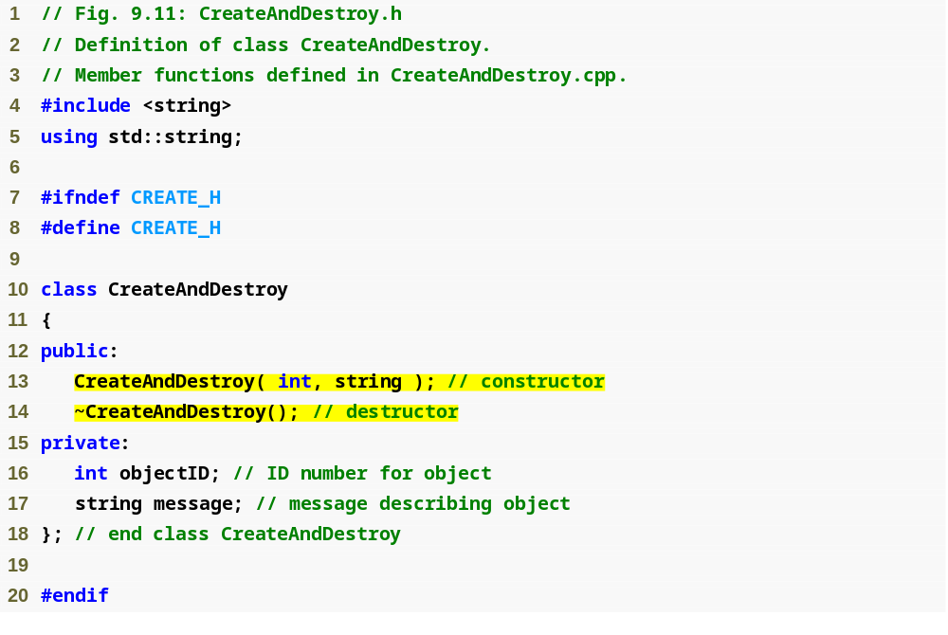
Outline
CreateAndDestroy.h
(1 of 1)
Prototype for destructor

Slide 66
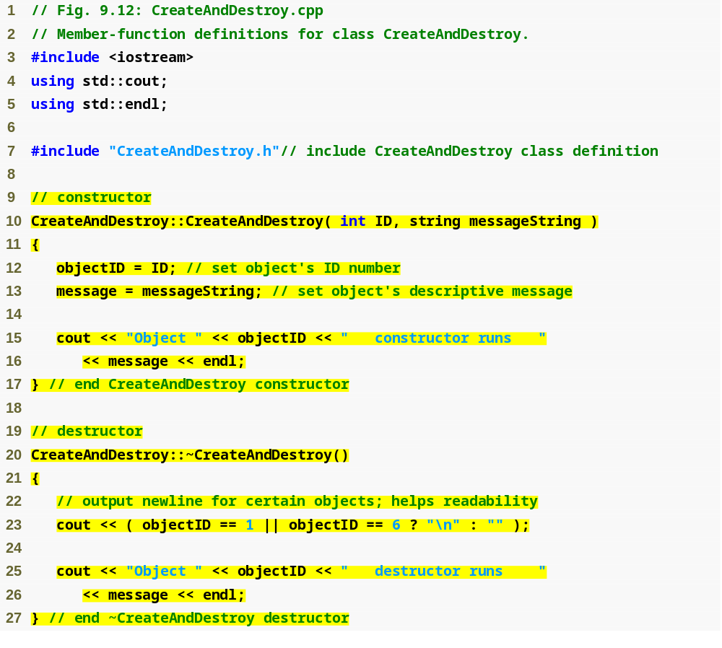
Outline
CreateAndDestroy.cpp
(1 of 1)
Defining the class’s destructor

Slide 67
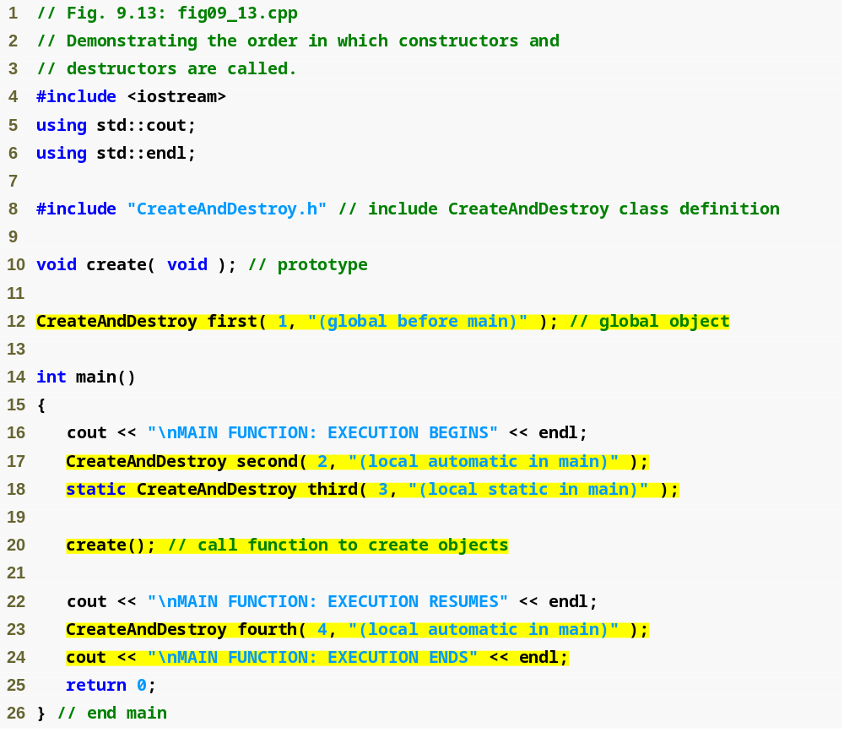
Outline
Fig09_13.cpp
(1 of 3)
Object created outside of main
Local automatic object created in main
Local static object created in main
Local automatic object created in main

Slide 68
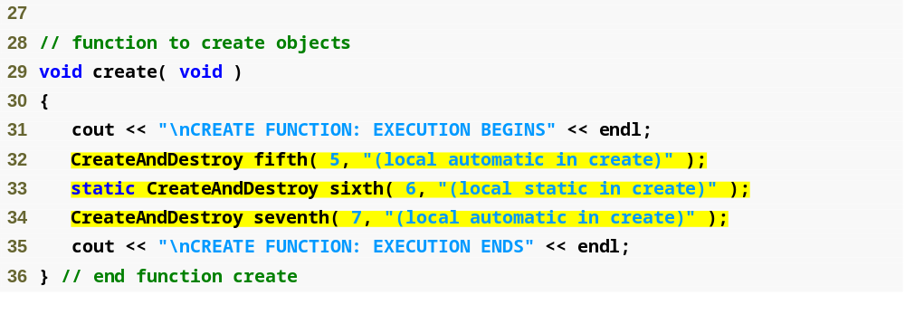
Outline
Fig09_13.cpp
(2 of 3)
Local automatic object created in create
Local static object created in create
Local automatic object created in create

Slide 69
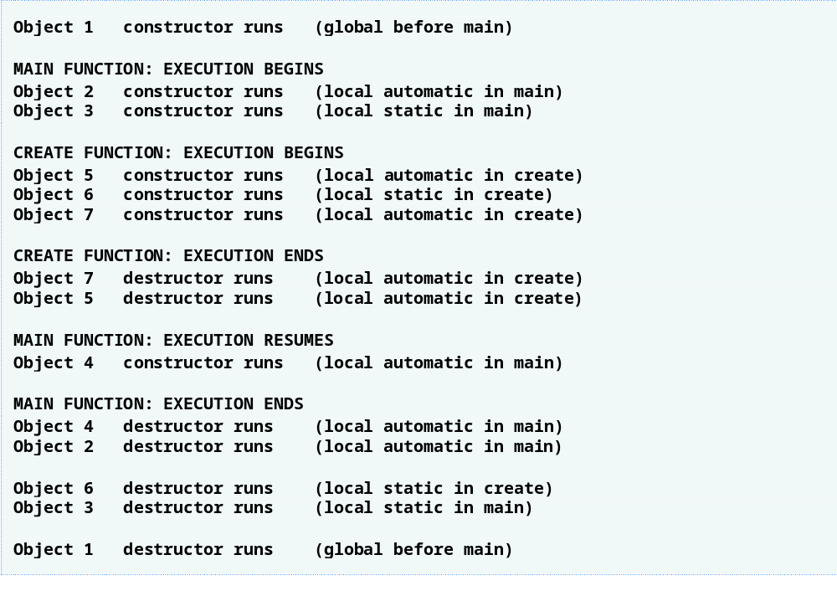
Outline
Fig09_13.cpp
(3 of 3)

Slide 70
9.9 Time Class Case Study: A Subtle Trap—Returning a Reference to a private Data Member
Returning a reference to an object
  Alias for the name of an object
    An acceptable lvalue that can receive a value
      May be used on the left side of an assignment statement
    If a function returns a const reference
      That reference cannot be used as a modifiable lvalue
  One (dangerous) way to use this capability
    A public member function of a class returns a reference to a private data member of that class
      Client code could alter private data
      Same problem would occur if a pointer to private data were returned

Slide 71
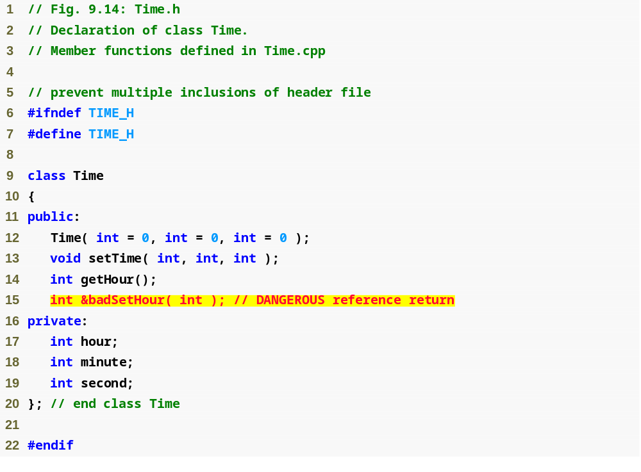
Outline
Time.h
(1 of 1)
Prototype for function that returns a reference

Slide 72
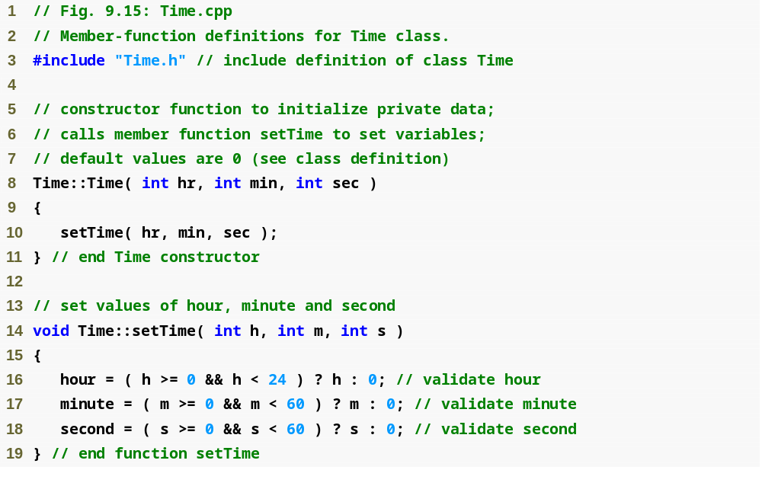
Outline
Time.cpp
(1 of 2)

Slide 73
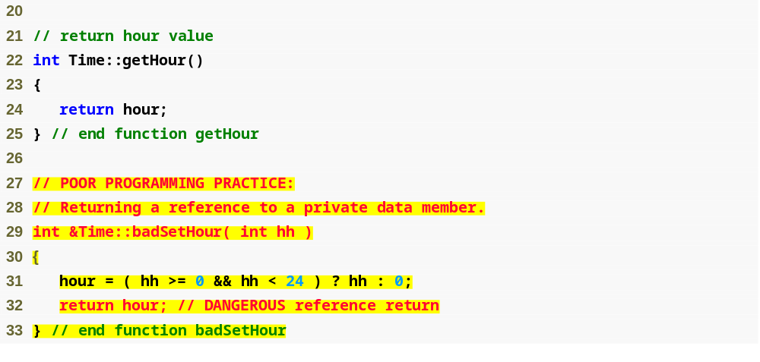
Outline
Time.cpp
(2 of 2)
Returning a reference to a private data member = DANGEROUS!

Slide 74
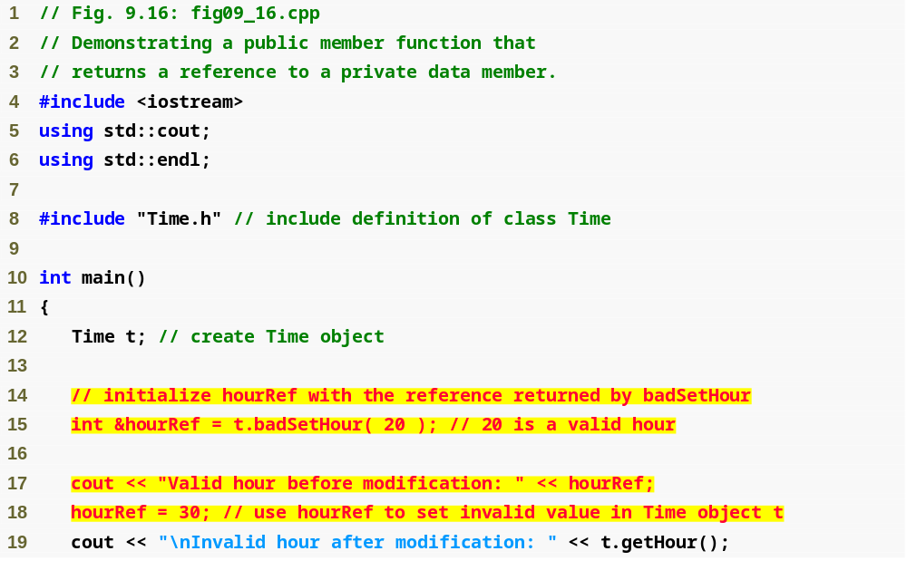
Outline
Fig09_16.cpp
(1 of 2)
Modifying a private data member through a returned reference

Slide 75
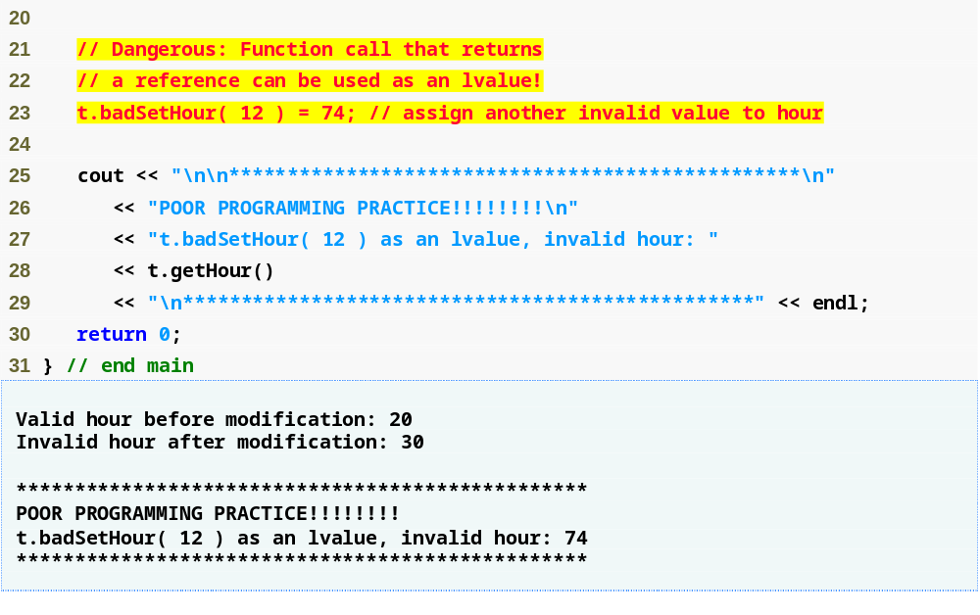
Outline
Modifying private data by using a function call as an lvalue
Fig09_16.cpp
(2 of 2)

Slide 76
Error-Prevention Tip 9.4
Returning a reference or a pointer to a private data member breaks the encapsulation of the class and makes the client code dependent on the representation of the class’s data. So, returning pointers or references to private data is a dangerous practice that should be avoided.

Slide 77
9.10 Default Memberwise Assignment
Default memberwise assignment
  Assignment operator (=)
    Can be used to assign an object to another object of the same type
      Each data member of the right object is assigned to the same data member in the left object
    Can cause serious problems when data members contain pointers to dynamically allocated memory

Slide 78
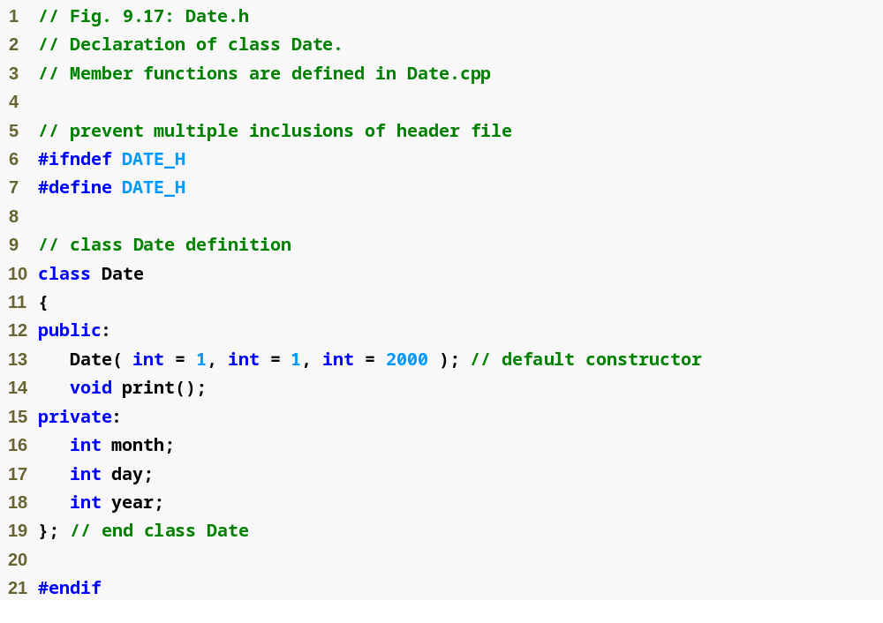
Outline
Date.h
(1 of 1)

Slide 79
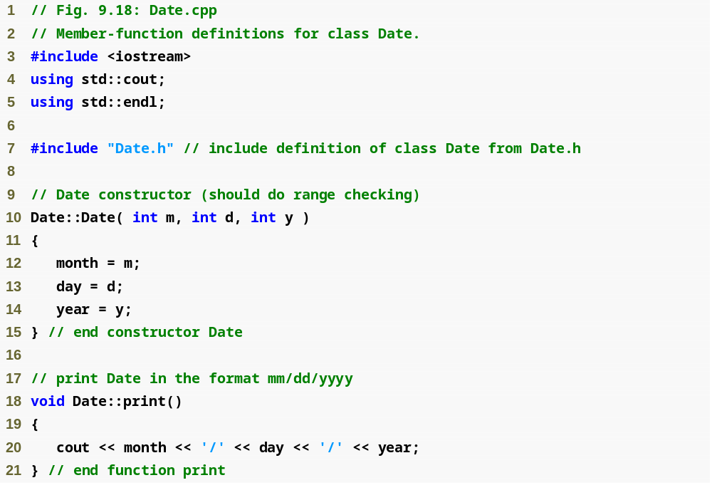
Outline
Date.cpp
(1 of 1)

Slide 80
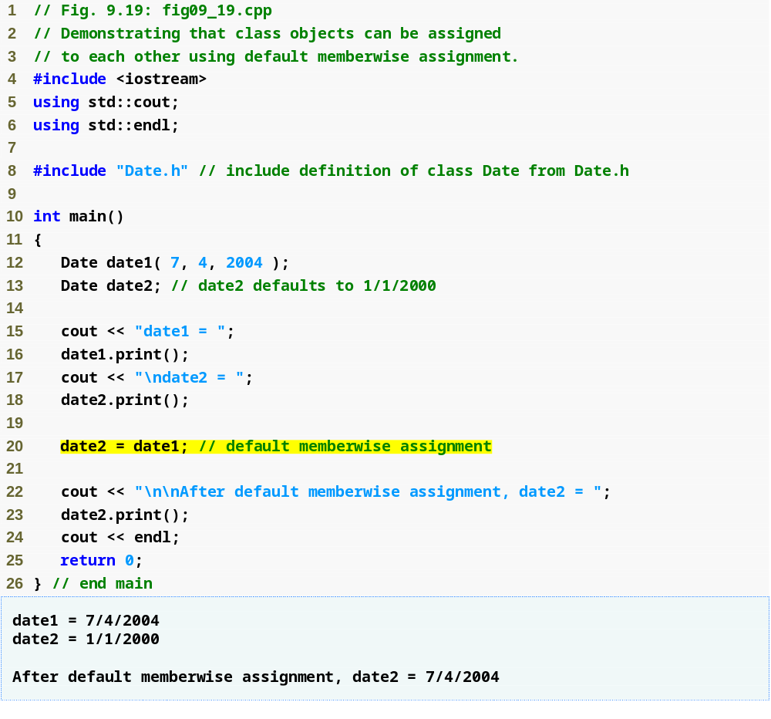
Outline
fig09_19.cpp
(1 of 1)
Memberwise assignment assigns data members of date1 to date2
date2 now stores the same date as date1

Slide 81
9.10 Default Memberwise Assignment (Cont.)
Copy constructor
  Enables pass-by-value for objects
    Used to copy original object’s values into new object to be passed to a function or returned from a function
  Compiler provides a default copy constructor
    Copies each member of the original object into the corresponding member of the new object (i.e., memberwise assignment)
  Also can cause serious problems when data members contain pointers to dynamically allocated memory

Slide 82
Performance Tip 9.3
Passing an object by value is good from a security standpoint, because the called function has no access to the original object in the caller, but pass-by-value can degrade performance when making a copy of a large object. An object can be passed by reference by passing either a pointer or a reference to the object. Pass-by-reference offers good performance but is weaker from a security standpoint, because the called function is given access to the original object. Pass-by-const-reference is a safe, good-performing alternative (this can be implemented with a const reference parameter or with a pointer-to-const-data parameter).

Slide 83
9.11 Software Reusability
Many substantial class libraries exist and others are being developed worldwide
Software is increasingly being constructed from existing, well-defined, carefully tested, well-documented, portable, high-performance, widely available components
Rapid applications development (RAD)
  Speeds the development of powerful, high-quality software through the mechanisms of reusable componentry

Slide 84
9.11 Software Reusability (Cont.)
Problems to solve before realizing the full potential of software reusability
  Cataloging schemes
  Licensing schemes
  Protection mechanisms to ensure that master copies of classes are not corrupted
  Description schemes so that designers of new systems can easily determine whether existing objects meet their needs
  Browsing mechanisms to determine what classes are available and how closely they meet software developer requirements
  Research and development problems
Great motivation to solve these problems
  Potential value of their solutions is enormous

Slide 85
9.12 (Optional) Software Engineering Case Study:
Starting to Program the Classes of the ATM System
Visibility of an object’s attributes and operations
  Determined by access specifiers
  Data members normally have private visibility
  Member functions normally have public visibility
  Utility functions normally have private visibility
UML Visibility Markers
  Placed before an operation or an attribute
  Plus sign (+) indicates public visibility
  Minus sign (–) indicates private visibility

Slide 86
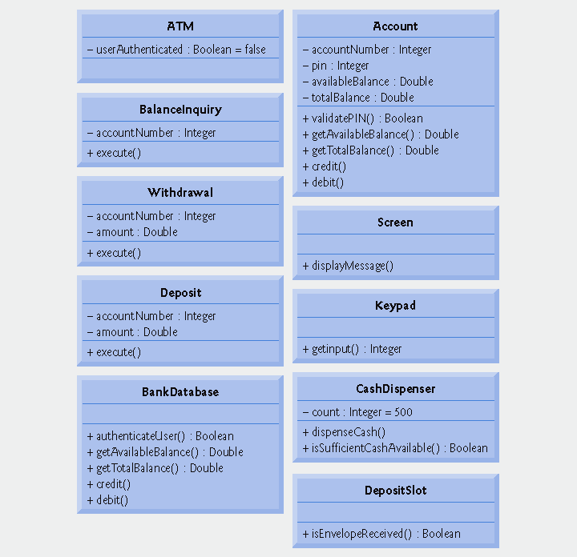
Fig. 9.20 | Class diagram with visibility markers.

Slide 87
9.12 (Optional) Software Engineering Case Study:
Starting to Program the Classes of the ATM System (Cont.)
UML Navigability Arrows
  Arrows with stick arrowheads in a class diagram
  Indicate in which direction an association can be traversed
  Based on the collaborations modeled in communication and sequence diagrams
  Help determine which objects need references or pointers to other objects
  Bidirectional navigability
    Indicated by arrows at both ends of an association or no arrows at all
    Navigation can proceed in either direction across the association

Slide 88
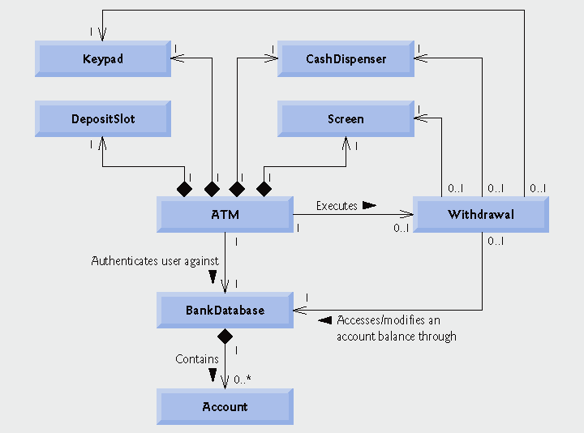
Fig. 9.21 | Class diagram with navigability arrows.

Slide 89
9.12 (Optional) Software Engineering Case Study:
Starting to Program the Classes of the ATM System (Cont.)
Implementing a class from its UML design
  Use the name located in the first compartment of a class diagram to define the class in a header file
  Use the attributes located in the class’s second compartment to declare the data members
  Use the associations described in the class diagram to declare references (or pointers, where appropriate) to other objects
    Use forward declarations for references to classes (where possible) instead of including full header files
      Helps avoid circular includes
        Preprocessor problem that occurs when header file for class A #includes header file for class B and vice versa
  Use the operations located in the class’s third compartment to write the function prototypes of the class’s member functions

Slide 90
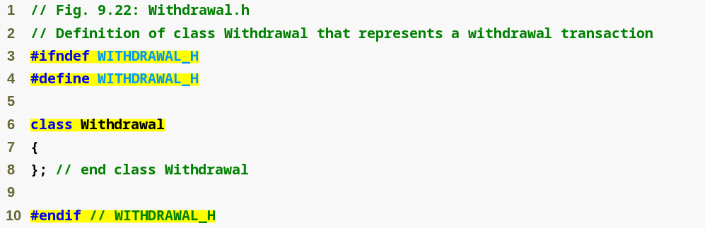
Outline
#ifndef, #define and #endif preprocessor directives help prevent multiple-definition errors
fig09_22.cpp
(1 of 1)
Class name is based on the top compartment of the class diagram

Slide 91
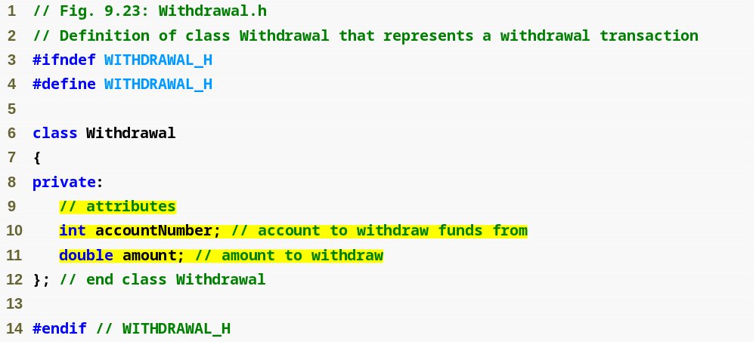
Outline
Withdrawal.h
(1 of 1)
Data members are based on the attributes in the middle compartment of the class diagram

Slide 92
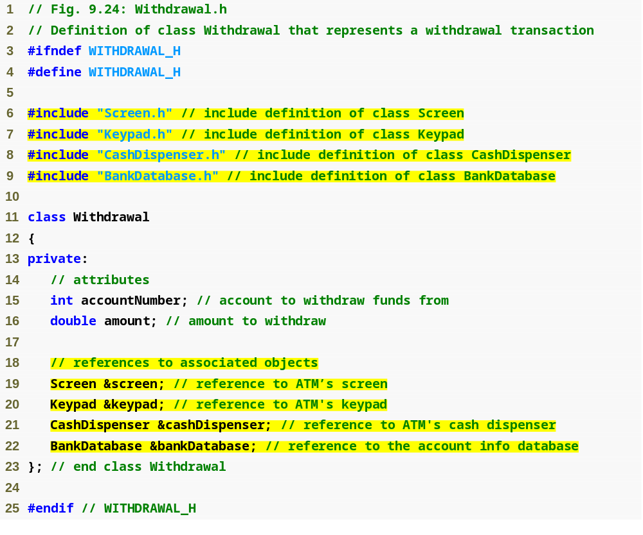
Outline
#include preprocessor directives for classes of associated objects
Withdrawal.h
(1 of 1)
References are based on the associations in the class diagram

Slide 93
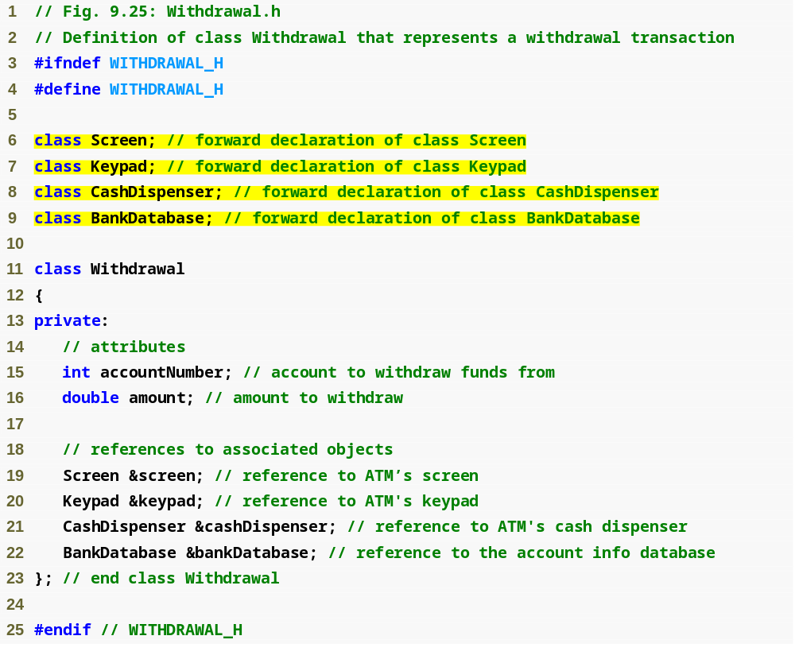
Forward declarations of classes for which this class has references
Outline
Withdrawal.h
(1 of 1)

Slide 94
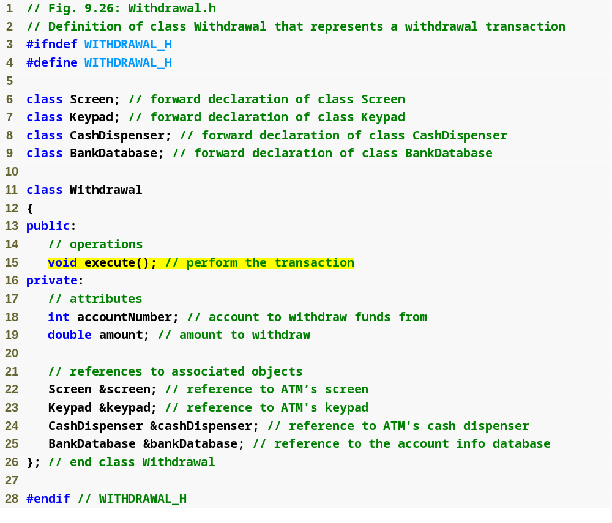
Outline
Withdrawal.h
(1 of 1)
Member functions are based on operations in the bottom compartment of the class diagram

Slide 95
Software Engineering Observation 9.12
Several UML modeling tools can convert UML-based designs into C++ code, considerably speeding the implementation process. For more information on these “automatic” code generators, refer to the Internet and Web resources listed at the end of Section 2.8.

Slide 96
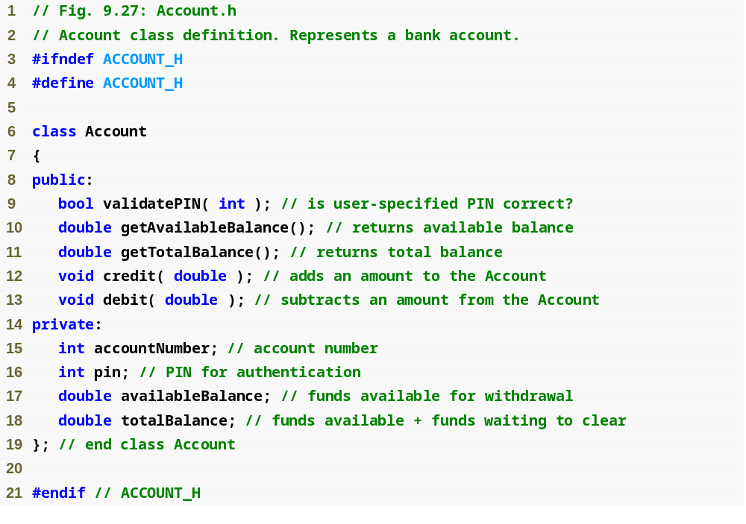
Outline
Account.h
(1 of 1)

